Slide 1
MICROSOFT'S NEW MOVIE STUDIO PROJECT
Presenter: WAITI PETER KIGOTHO.
Class : DSFP COHORT 15
SCHOOL : MORINGA

Slide 2
Business Problem
Microsoft sees all the big companies creating original video content and they want to get in on the fun. They have decided to create a new movie studio, but they don’t know anything about creating movies.
Objectives
Explore what types of films are currently doing the best at the box office.
Translate those findings into actionable insights that the head of Microsoft's new movie studio can use to help decide what type of films to create.

Slide 3
Methodology.
Data acquisition
Downloading the data inform of a zipped file.
The folder contained csv files with different movie data sets.
Most of the data used was collected from the IMDb movie website and other movie websites.
Importing and loading the data.
I created a function to read the files using pd.read_csv.
Displaying and Inspecting the data.
Checking for any missing values in all the dataframes.
Checking for duplicates.
Checking for unnecessary rows and columns
Checking for data types.
Checking for number of rows and columns.

Slide 4
Methodology.
Data cleaning
Filling the null values with the mean in int columns and Not_given in string columns.
Dropping unnecessary columns.
Dropping duplicates in each data frame
Merging the dataframes.
I merged the necessary dataframes for easier analysis.
Data Analysis
Analyze the movies and their genres with highest profit, based on profit generated from the worldwide gross.
Top10_Most popular movies and their genres.
Find the relationship between production budget and profit generated.
Find the most popular Genres in the top 1000 popular movies.
Find the most popular language that is used in the top 1000 popular movies
.

Slide 5
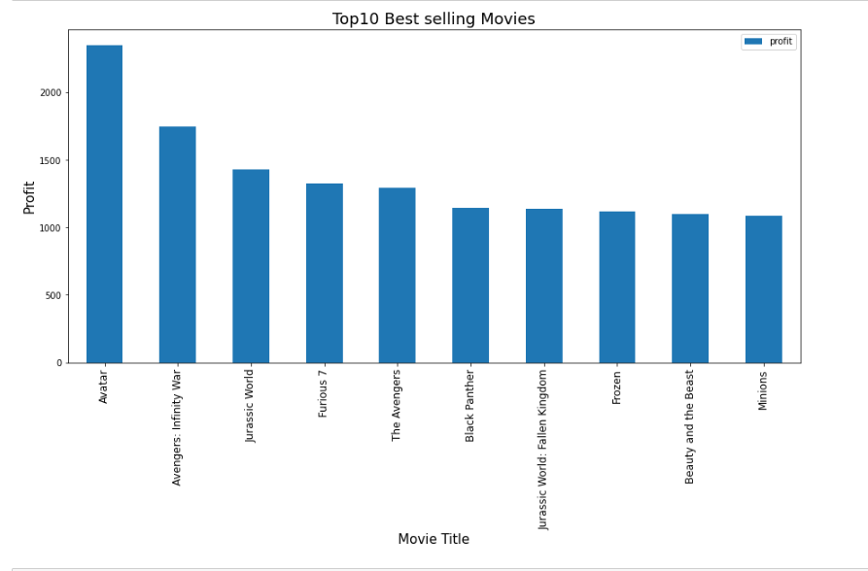
Findings
Top10 Best selling movies, based on profit generated worldwide.

Slide 6
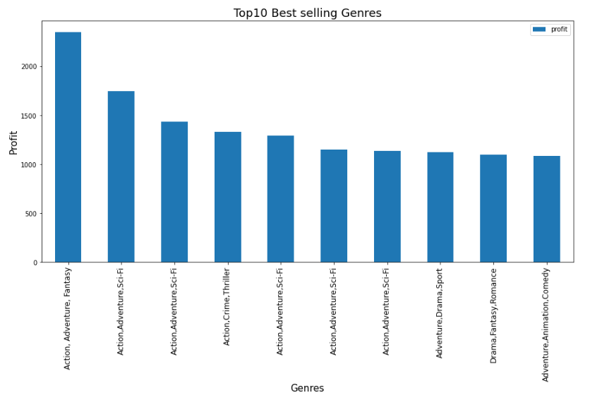
Findings
Top10 Best selling movie Genres, based on profit generated worldwide.

Slide 7
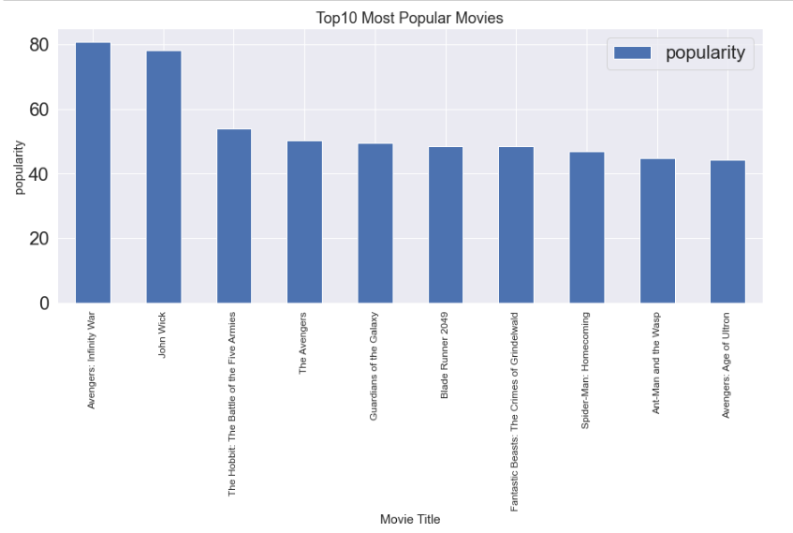
Findings
Top10_Most popular movies

Slide 8
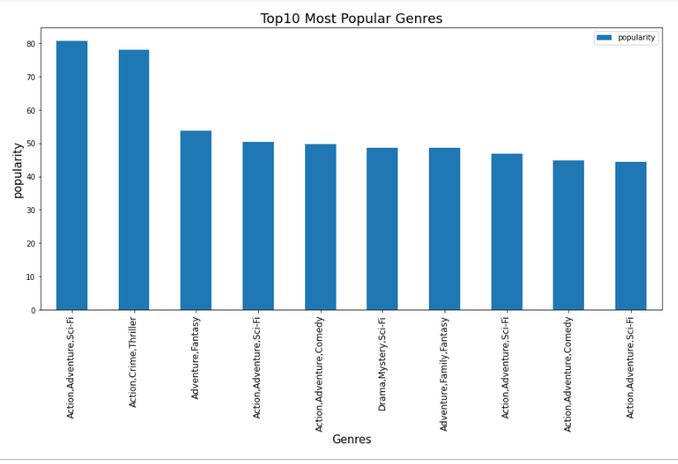
Findings
Top10_Most popular movie genres

Slide 9
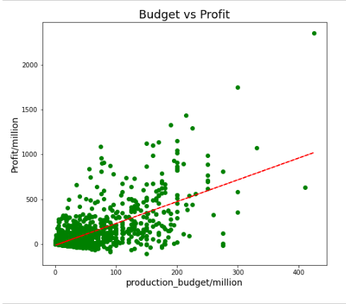
Findings
The relationship between production budget and profit generated.
From the scatter plot, we can see a generally tight positive correlation between a movie production budget and the profit. We can also observe some outlier points, where some movies have less than 200 million$ production budget and make higher profits of upto 2 billion$ and other movies with higher production budgets such as 400 million$ and made less profits as low as negative profits.

Slide 10
Findings
Find popular Genres
Some movies have been categorized with more than one movie genre.
Movies such as Avatar have a combination of genres i.e action, adventure and Fantasy.
In order to find the most popular genre there is need to split these genres into three columns for easier analysis

Slide 11
Findings
Find popular Genres

Slide 12
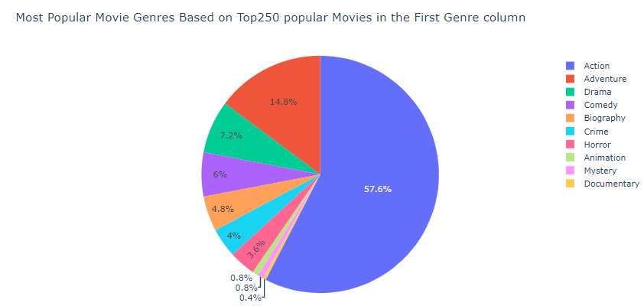
Findings
Find popular Genres

Slide 13
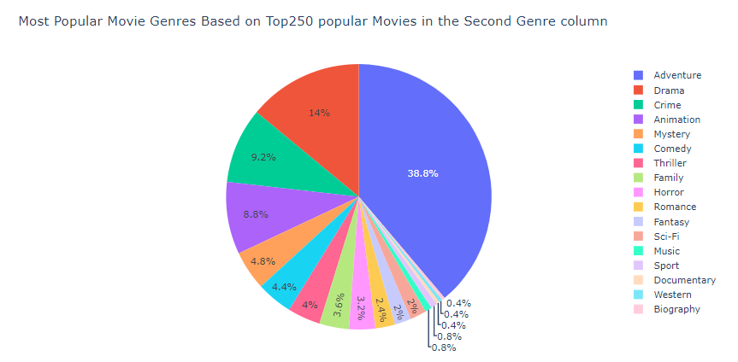
Findings
Find popular Genres

Slide 14
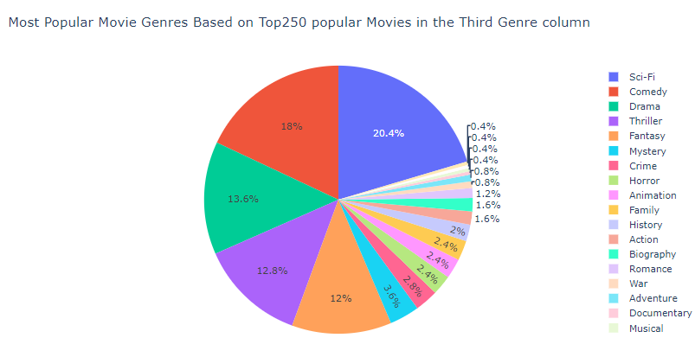
Findings
Find popular Genres

Slide 15
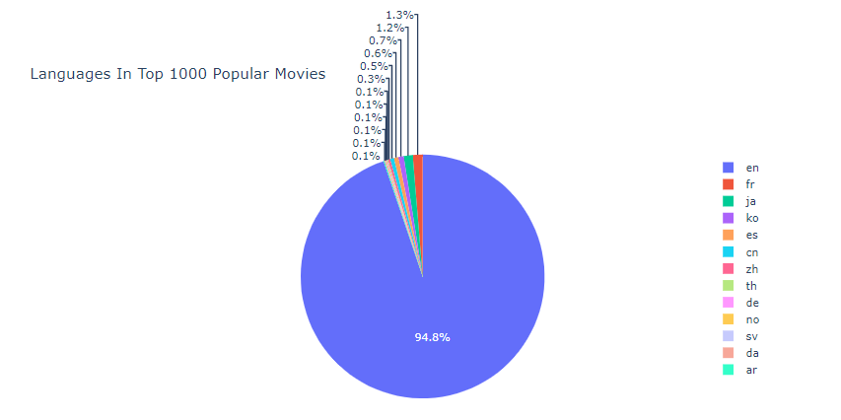
Findings
The Most used Language in Top1000 popular movies

Slide 16
Conclusion
From the correlation analysis between production budget and profit generated we notice that production budget influences the amount of profit generated But in some instances its not always the case.
We also see that most popular movies and most profitable movies are the ones that have a combination of movie genres.

Slide 17
Conclusion
From the pie charts above we can see that there are three most popular genres i.e.
Action, Adventure and Sci-Fi.
These three genre combinations makes up the most popular movies and can make a good combination for the audience .
Other popular movie genres include.
Drama, Animation ,crime and Comedy genres.

Slide 18
Conclusion
Documentary, and Biography movies perform poorly in terms of popularity and profitability.
From the findings we realize that the most popular movies are in English with 94% appearance in the top 1000 popular movies

